Slide 1
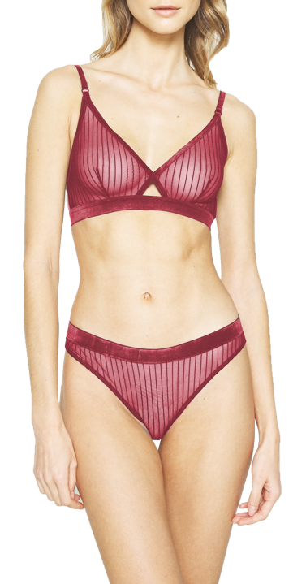
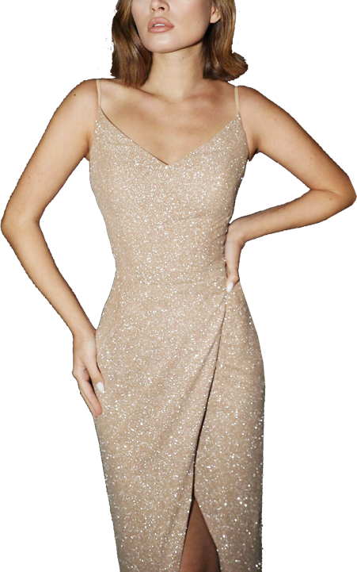

Fall / Holiday 23
Virtual Mill Week
INTIMATE & APPAREL
FABRIC COLLECTION
We Engineer Every Sensation! May, 2022
Notes:
Download more minimal templates here: https://crmrkt.com/GK9Dwa

Slide 2




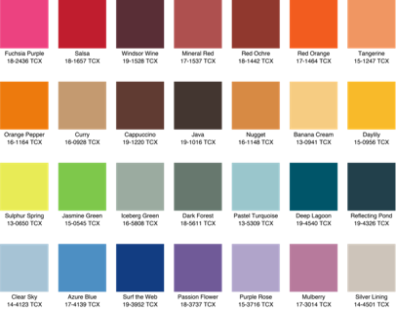
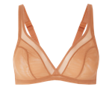
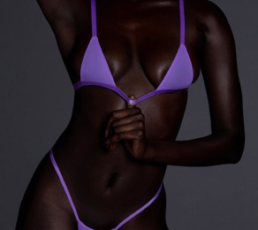
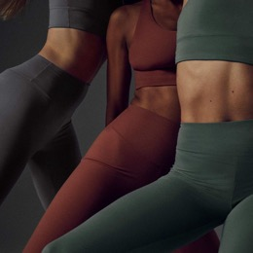

Fall / Holiday 23 Color Concept
CORE
BASICS:
NEW
PALETTE:
Colours for Fall / Holiday 23 will be a stronger and more holistic focus on health and healing, and this will see so , mindful pastels evolve into brighter, digitally infused wellness colours that feel sensorial and energising.
GLOSSY &
METALLIC:
* Actual color please refer Pantone no. or actual color swatches.

Slide 3






Key Takeaways
01. BIODEGRADABLE
03.NEW TEXTURES
Maximum Comfort
Jersey /Jacquard/Interlock
Mesh-like Jacquard
Mesh Hole / Subtle Dots Pattern
Fine Cotton Yarn Serie
Organic Cotton / Supima Cotton
Rib
Exquisite Rib / Tactile Rib
Stripe
Fancy Stripe / Tactile Stripe
Cozy Rib
Modal / Organic Cotton / Bamboo / Rib
Sheer Jacquard / 3D Pattern Jacquard
Pattern
Jacquard
Glamour Shine
Metallic Jersey
02. Recycle
04. Multi-functional & Lace
Jersey / 360 Stretch/ Interlock
LOVE
YOURSELF
Nylon 6 – Collagen
Far Infrared
Deodorizing
Jersey & Interlock
Texture Fabric
Sherry Stripe / Delicate Jacquard / Rib
Recycled Nylon + LYCRA® ADAPTIV
Good Fit Interlock
UNFORGETTABLE
LACE
Clean Cut Lace
New Development
Notes:
Download more minimal templates here: https://crmrkt.com/GK9Dwa

Slide 4






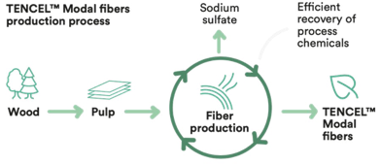
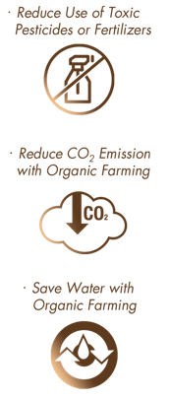
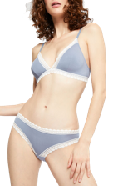
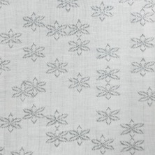
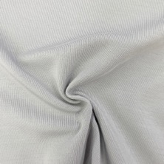

BIODEGRADABLE FOR INTIMATE
BIODEGRABLE - for Intimate
Maximum Comfort
Natural Fiber
Biodegradable
Long-lasting
Softness
Enhanced
Breathability
Jersey
Cozy Jacquard
Micro Modal Fiber
Softer & Cozier than Regular
Organic Cotton
SH-15815(R2)QGZ
SE-15894(CS)
47% 60S Modal
81% 80S Micro Modal
46% Organic Cotton
19% Elastane
7% Elastane
70” X 145 gsm
65” X 150 gsm
Feather-light Fineness Fibers from Beech Trees
(Renewable Source Material Wood)
Natural Stretch and Weightless Comfort
“ Supreme Drapability with natural soft touch makes you intoxicating in daily comfort. ”

Slide 5



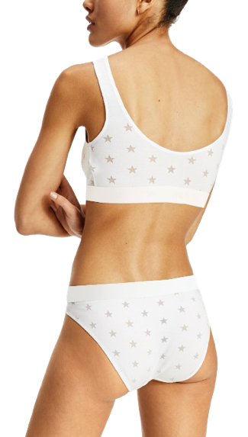
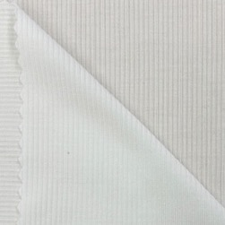
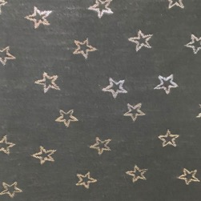
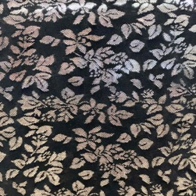
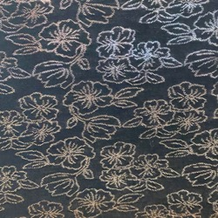
BIODEGRADABLE FOR INTIMATE
BIODEGRABLE - for Intimate
Maximum Comfort
Natural Fiber
Biodegradable
Sheer & Sexy
Gentle
on Skin
Enhanced
Breathability
Cozy Jacquard
SE-15892(CS)
SE-15895(CS)
SE-15893(CS)
81% 80S Micro Modal
81% 80S Micro Modal
81% 80S Micro Modal
19% Elastane
19% Elastane
19% Elastane
62” X 150 gsm
63” X 160 gsm
63” X 180 gsm

Slide 6


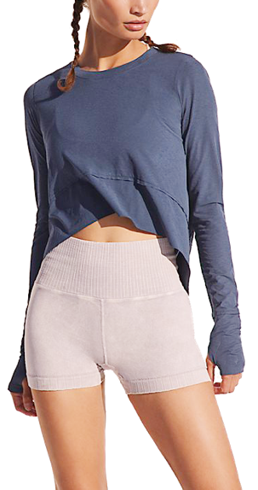

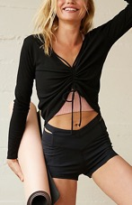
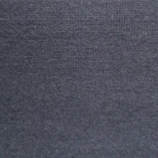
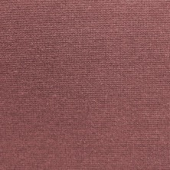

BIODEGRADABLE FOR APPAREL
BIODEGRABLE - for Apparel
Maximum Comfort
Natural Fiber
Biodegradable
No Curling
No Fraying
Natural
Touch
Interlock
SR-16040(R2)(CS)Z
SR-16039(R2)(CS)Z
48% 60S Micro Modal
49% Micro Modal
47% Organic Cotton
47% Organic Cotton
5% Elastane
4% Elastane
42” X 175 gsm
46” X 200 gsm

Slide 7

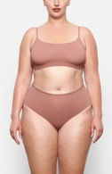


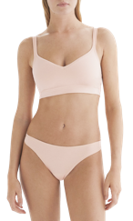
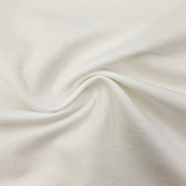
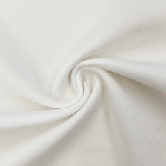
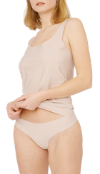
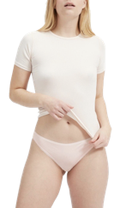
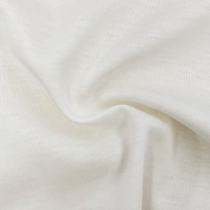
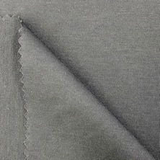
SUSTAINABILITY FOR INTIMATE
Biodegradable - for Intimate
Fine Yarn Cotton Serie
Natural Fiber
Biodegradable
Comfortable
Fit
Organic Cotton Jersey
Supima Cotton Interlock
SH-15785(SS)(R2)Z
SH-15121(R2)(SS)NZCY
SR-10443(F)GN
SR-14955(TF)WNZ
88% 80S Organic Cotton
88% 60S Organic Cotton
85% 80S Supima Cotton
88% 80S Supima Cotton
12% Elastane
12% Elastane
15% Elastane
12% Elastane
No Curling
No Fraying
67” X 135 gsm
70” X 180 gsm
60” X 160 gsm
62” X 180 gsm

Slide 8
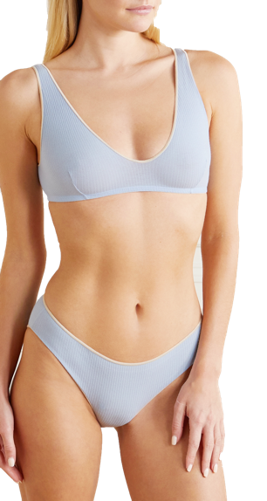
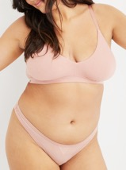
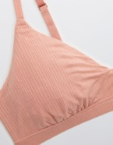
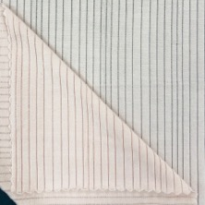
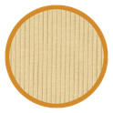
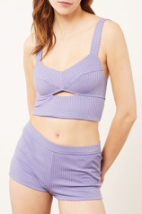
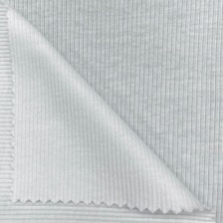
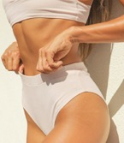
BIODEGRADABLE FOR INTIMATE
BIODEGRABLE - for Intimate
Cozy Rib
Natural Fiber
Biodegradable
Long-lasting
Softness
Enhanced
Breathability
SH-15992(SG)(CS)
SR-15471(R2)(CS)
89% 80S Micro Modal
48% Micro Modal
11% Elastane
48% Organic Cotton
4% Elastane
51” X 130 gsm
42” X 170 gsm

Slide 9
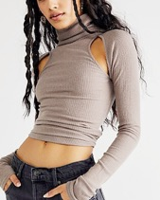
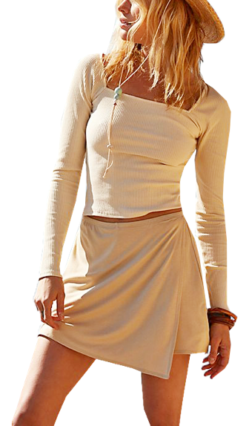
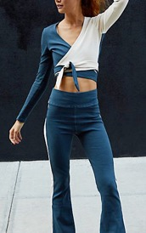
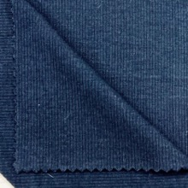
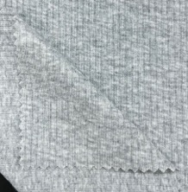
BIODEGRADABLE FOR APPAREL
Viscose from Bamboo
BIODEGRABLE - for Apparel
Cozy Rib
Natural Fiber
Biodegradable
Long-lasting
Softness
SR-15617(B1)
SR-15474H(R2)(BOC11B<ZR>)
62% Viscose from Bamboo
93% Organic Cotton
34% Cotton
7% Elastane
4% Elastane
51” X 180 gsm
62” X 200 gsm

Slide 10



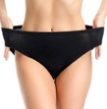


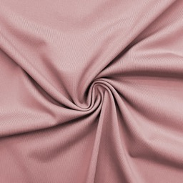
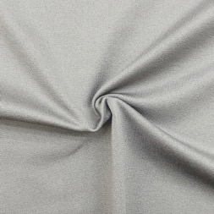
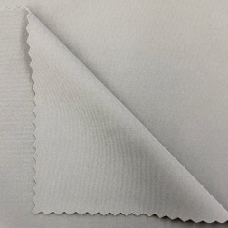





SUSTAINABILITY FOR INTIMATE
Recycled - for Intimate
Jersey & Interlock
Lightweight
Coverage
Eco-friendly
Single Jersey
360^{O} Stretch
Interlock
SH-14870(SF)W(L)
SH-14853FW(L)
SR-14937(TK)W(L)-2
79% Recycled Nylon
85% Recycled Nylon
78% Recycled Nylon
21% Elastane
15% Elastane
22% Elastane
52” X 120 gsm
61” X 145 gsm
64” X 145 gsm
Ultra-lightweight
One Size
Fit Most
Clean Cut

Slide 11


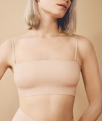
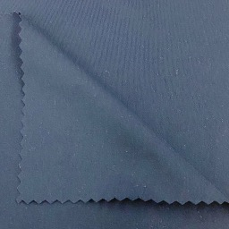
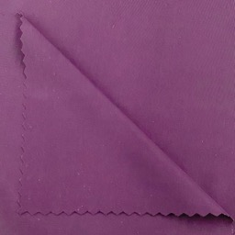
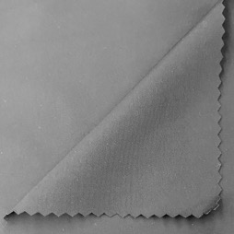
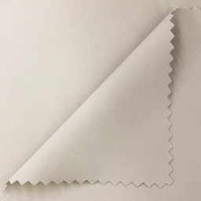
SUSTAINABILITY FOR INTIMATE
Recycled - for Intimate
Nylon
Eco-friendly
SR-15546(TF)(L)
SR-15773(TF)(L)
SR-15950(TF)(L)
SR-15422(TK)W(L)
72% Recycled Nylon
70% Recycled Nylon
73% Recycled Nylon
74% Recycled Nylon
28% Elastane
30% Elastane
27% Elastane
26% Elastane
57” X 100 gsm
55” X 140 gsm
50” X 160 gsm
62” X 160 gsm

Slide 12









SUSTAINABILITY FOR INTIMATE
Recycled - for Intimate
Textured Fabric
Eco-friendly
Sheer Stripe
Delicate Jacquard
Rib
SH-14951W(L)
SE-15540(L)
SR-15359(JG)(L)
65% Recycled Nylon
72% Recycled Nylon
62% Recycled Nylon
26% Nylon
28% Elastane
38% Elastane
9% Elastane
40” X 105 gsm
52” X 140 gsm
60” X 145 gsm
Breathable
Sheer & Sexy
Clean Cut

Slide 13




SUSTAINABILITY FOR INTIMATE
Recycled - for Intimate
Recycled Nylon + LYCRA® ADAPTIV
LYCRA® ADAPTIV
RD-15771(TF)(L)
RD-15742(TF)(L)
74% Recycled Nylon
74% Recycled Nylon
26% Elastane
26% Elastane
59” X 120 gsm
50” X 160 gsm

Slide 14








NEW TEXTURES FOR INTIMATE
NEW TEXTURES - for Intimate
Mesh-like Jacquard
Breathable
SJ-15810(SG)(CS)T
SJ-13577(SG)W
SJ-15919(R2)T
56% 100S Micro Modal Air
61% Nylon
93% Organic Cotton
35% Nylon
39% Elastane
2% Nylon
9% Elastane
5% Elastane
60” X 100 gsm
51” X 105 gsm
65” X 145 gsm

Slide 15











NEW TEXTURES FOR INTIMATE
NEW TEXTURES - for Intimate
Exquisite Rib
No Curling
No Fraying
Subtle & Flat Rib
SR-16046(JG)-2
SR-15748(TK)
63% Nylon
52% Nylon
37% Elastane
48% Elastane
48” X 90 gsm
63” X 115 gsm

Slide 16







NEW TEXTURES FOR INTIMATE
NEW TEXTURES - for Intimate
Fancy Stripe
Jersey
Jacquard
Rib
SH-15727(SF)
SJ-15284T(J)
SR-15955(JG)
64% Nylon
68% Nylon
65% Nylon
36% Elastane
17% Cotton
15% Elastane
35% Elastane
67” X 85 gsm
41” X 125 gsm
53” X 120 gsm
Breathable
Sheer & Sexy

Slide 17








NEW TEXTURES FOR INTIMATE
NEW TEXTURES - for Intimate
Sheer Jacquard
Breathable
Sheer & Sexy
SE-15885
SR-15335(JG)U
SE-15739
SJ-15497
SE-15905
73% Nylon
60% Nylon
79% Nylon
89% Polyester
75% Nylon
27% Elastane
40% Elastane
21% Elastane
11% Elastane
25% Elastane
58” X 85 gsm
52” X 120 gsm
59” X 90 gsm
55” X 130 gsm
70” X 110 gsm

Slide 18








NEW TEXTURES FOR APPAREL
NEW TEXTURES - for Apparel
Mesh-like Jacquard
Breathable
SJ-15841
SR-15763(TG)
74% Nylon (Tactel)
68% Nylon
18% Nylon
32% Elastane
8% Elastane
38” X 115 gsm
53” X 130 gsm

Slide 19






NEW TEXTURES FOR APPAREL
NEW TEXTURES - for Apparel
Tactile Rib
Multi Visual Effect
with
different mix-and-match colors
Two-tone Rib
SR-15795(TG)TT
45% Nylon
33% Polyester
22% Elastane
60” X 190 gsm
Clean Cut

Slide 20







NEW TEXTURES FOR APPAREL
NEW TEXTURES - for Apparel
Tactile Stripe
Jersey
Interlock
SH-15302(SG)WT(J)
SR-15850(JF)-2
SR-15861(TG)
66% Supima Cotton
48% Nylon
79% Nylon
24% Nylon
52% Elastane
21% Elastane
10% Elastane
63” X 130 gsm
51” X 175 gsm
54” X 210 gsm

Slide 21







NEW TEXTURES FOR APPAREL
NEW TEXTURES - for Apparel
3D Pattern Jacquard
SE-15725
SE-15782
SE-15887
SE-16015
57% Nylon
63% Nylon
49% Nylon
49% Nylon
43% Elastane
37% Elastane
51% Elastane
51% Elastane
54” X 175 gsm
63” X 190 gsm
60” X 200 gsm
54” X 175 gsm

Slide 22







ADD SHINE TO THE DAY
GLAMOUR SHINE
Metallic Jersey
Perfect for
Intimate & Apparel
Metallic
SH-15010WMAS(HAK-140<7>)
79% Nylon
7% Metallic
14% Elastane
55” X 125 gsm

Slide 23


FUNCTIONALITY
The NEW Functional textiles will bring
enhanced comfort, wellness and performance

Slide 24








MULTI-FUNCTIONS – NYLON 6 – COLLAGEN
Multi-function
Nylon 6 - Collagen
High-quality collagen, called “soft gold for skin”, is extracted from marine fish and compounded into Nylon 6 yarn by nano-technology, thus producing collagen nylon yarn with skin-friendliness, comfort and multiple functions.
Eco-friendly
Skin-friendly
Collagen from marine fish, which has no common diseases with human beings, is superior in quality compared with collagen extracted from cattle, sheep, chickens, etc., and will not cause allergic reactions to human beings. Meanwhile, it is rich in amino acids, and has natural affinity for human skin and good comfort.
Cooling
Moisture Absorption
Long-lasting Effectiveness
Its performance remains excellent after repeated washing
Anti-bacterial & Deodorizing
This multifunctional yarn can inhibit bacterial growth, reduce possibility of bacterial infection and the unpleasant smell caused by it.

Slide 25








MULTI-FUNCTIONS – NYLON 6 – COLLAGEN
Multi-function
Nylon 6 - Collagen
RD-15591(JG)
SR-15502(TF)W
66% Nylon
69% Nylon
34% Elastane
31% Elastane
50” X 95 gsm
55” X 140 gsm
Clean Cut
Clean Cut
** This third-party certification report is entrusted by Tianfangbiao Standardization Certification & Testing Co.,Ltd.
** Test results are for reference only.

Slide 26






MULTI-FUNCTIONS – FAR INFRARED
Multi-function
Far Infrared
The Innovation of Health Care Textile
Exceptional Comfort
Dry Touch
Flawless Full-coverage Fit
Health Care & Staying Warm
Featherlight
Stay Warm

Slide 27







MULTI-FUNCTIONS – FAR INFRARED
Multi-function
Far Infrared
SR-15789(TF)
72% Nylon (FIR)
28% Elastane
56” X 150 gsm
Clean Cut

Slide 28














FUNCTIONALITY – DEODORIZING
Functionality
Deodorizing
Lightweight
Natural
Touch
Breathable
( Airy & Fresh )
Moisture
Management
Good Stretch
& Recovery
Gentle on Skin
Hot Item
Deodorizing
SH-13862(SS)T(J)(M)
Fall in love with the unbeatable
second-skin feeling. It is an incomparable feeling of freshness, lightness and flexibility all days long. Wear it and love it.
46% Nylon(Tactel) 42% 80S Supima Cotton 12% Elastane
66” X 135gsm
Can Apply creora® Fresh Hangtag

Slide 29












FUNCTIONALITY – DEODORIZING
Functionality
Deodorizing
Lightweight
Natural Soft
Touch
Deodorizing
Good Stretch
& Recovery
Breathable
( Airy & Fresh )
Subtle Dot Jacuqard
SJ-14320U(J)(M)
94% Polyester 6% Elastane
67” X 145gsm

Slide 30



















CLASSIC FEMININITY FOR INTIMATE
Unforgettable Lace
2023 Pattern Concept
All rights reserved by Sun Hing Textiles (Hong Kong) Limited

Slide 31








CLASSIC FEMININITY FOR INTIMATE
Unforgettable Lace
Clean Cut Lace
JU885850
JU885846
JU885885
69% Nylon
70% Nylon
67% Nylon
Clean Cut
31% Elastane
30% Elastane
33% Elastane
Width: 155 cm
Width: 155 cm
Width: 155 cm
JUN885706
JU885900
JU885901
67% Nylon
69% Nylon
69% Nylon
33% Elastane
31% Elastane
31% Elastane
Width: 155 cm
Width: 155 cm
Width: 160 cm

Slide 32









CLASSIC FEMININITY FOR INTIMATE
Unforgettable Lace
New Development
100% Recycled Lace
Eco-friendly
Recycled Nylon
Recycled Elastane
FCFC uses 100% Recycled CPL to produce nylon chip to make Recycled Yarn.
By using Recycled CPL, saving energy & reduce 15% of fresh CPL.
Reduce waste water and energy, reduce 14.9% of CO2. (Reduce -21,499 Ton CO@/Year – plant 46,233 tress of 40 years.)
100% Recycled Spandex / Elastane made with
pre-consumer waste
With every ton of 100% reclaimed waste Hyosung uses to produce its GRS certified creora® regen elastane. It save approximately 2 tons of non-renewable raw material being extracted from the earth.
Can Apply Formo Eco Hangtag
Can Apply creora® Regen Hangtag

Slide 33




MG905820HH
CLASSIC FEMININITY FOR INTIMATE
Unforgettable Lace
New Development
Eco-friendly
MG905939HH
M905903HH
87% Recycled Nylon
84% Recycled Nylon
85% Recycled Nylon
13% Recycled Elastane
16% Recycled Elastane
15% Recycled Elastane
Width: 23 cm
Width: 23 cm
Width: 23 cm

Slide 34

Should you have any questions, please feel free to contact
Thank you!
May Wong
Chris Huang
may@shltd.com
Chris.Huang@shltd.com
+852 2212 8281
+0086 0755 27121828 ext. 3305
Notes:
Download more minimal templates here: https://crmrkt.com/GK9Dwa

